Slide 1
dual axis map
File created on: 4/21/21 12:40:37 PM GMT+05:30

Slide 2
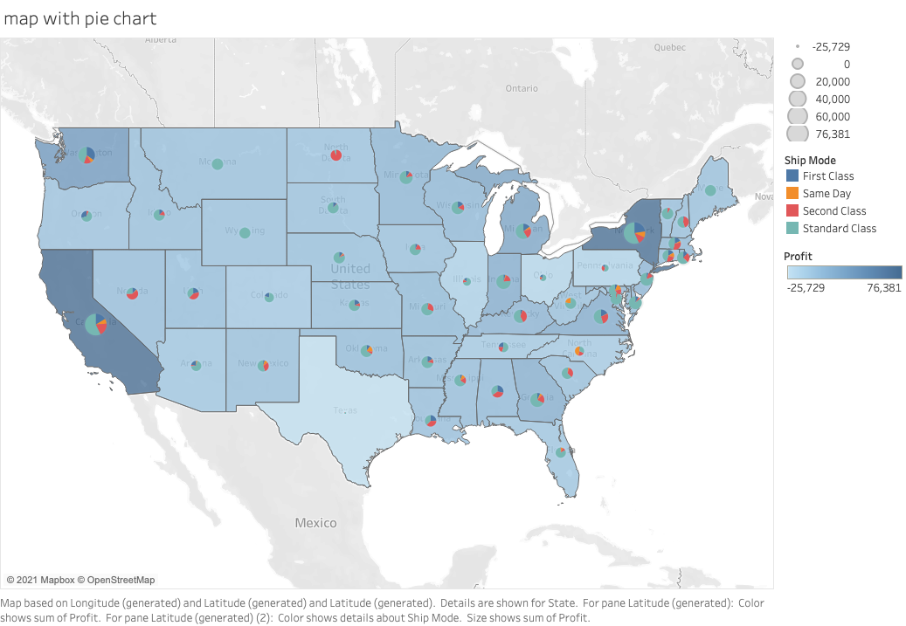

Slide 3
